Slide 1

Distributed Filesystems
Engin Arslan
Jan 28, 2020
Engin Arslan
Distributed Filesystems
1 / 32

Slide 2

What is Filesystem?
◮ Controls how data is stored in and retrieved from disk.
Engin Arslan
Distributed Filesystems
2 / 32

Slide 3
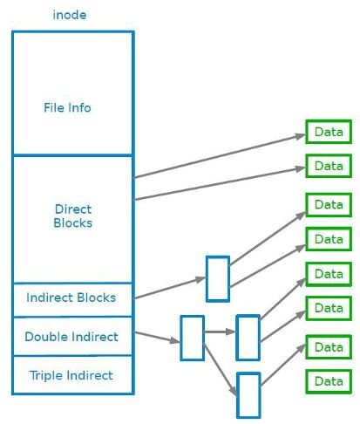
What is Filesystem?
◮ Controls how data is stored in and retrieved from disk.
Engin Arslan
Distributed Filesystems
Jan 29, 2019
3 / 32

Slide 4
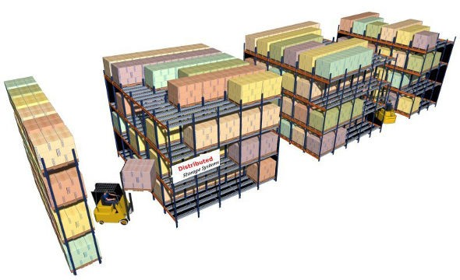
Distributed Filesystems
◮ When data outgrows the storage capacity of a single machine: partition it across a number of separate machines.
◮ Distributed filesystems: manage the storage across a network of machines.
Engin Arslan
Distributed Filesystems
4 / 32

Slide 5

Engin Arslan
Distributed Filesystems
Jan 30, 2018
5 / 32

Slide 6

HDFS
◮ Hadoop Distributed FileSystem
◮ Appears as a single disk
◮ Runs on top of a native filesystem, e.g., ext3
◮ Fault tolerant: can handle disk crashes, machine crashes, ...
◮ Based on Google’s filesystem GFS
Engin Arslan
Distributed Filesystems
Jan 30, 2018
6 / 32

Slide 7
HDFS is Good for ...
◮ Storing large files
Terabytes, Petabytes, etc...
100MB or more per file.
◮ Streaming data access
Data is written once and read many times.
Optimized for batch reads rather than random reads.
◮ Cheap commodity hardware
No need for supercomputers, use less reliable commodity hardware.
Engin Arslan
Distributed Filesystems
Jan 30, 2018
7 / 32

Slide 8
HDFS is Not Good for ...
◮ Low-latency reads
High-throughput rather than low latency for small chunks of data.
HBase addresses this issue.
◮ Large amount of small files
Better for millions of large files instead of billions of small files.
◮ Multiple writers
Single writer per file.
Writes only at the end of file, no-support for arbitrary offset.
Engin Arslan
Distributed Filesystems
Jan 30, 2018
8 / 32

Slide 9
HDFS Daemons (1/2)
◮ HDFS cluster is manager by three types of processes.
◮ Namenode
Manages the filesystem, e.g., namespace, meta-data, and file blocks
Metadata is stored in memory.
Engin Arslan
Distributed Filesystems
Jan 30, 2018
8 / 32

Slide 10
HDFS Daemons (1/2)
◮ HDFS cluster is manager by three types of processes.
◮ Namenode
Manages the filesystem, e.g., namespace, meta-data, and file blocks
Metadata is stored in memory.
◮ Datanode
Stores and retrieves data blocks
Reports to Namenode
Runs on many machines
Engin Arslan
Distributed Filesystems
Jan 30, 2018
8 / 32

Slide 11
HDFS Daemons (1/2)
◮ HDFS cluster is manager by three types of processes.
◮ Namenode
Manages the filesystem, e.g., namespace, meta-data, and file blocks
Metadata is stored in memory.
◮ Datanode
Stores and retrieves data blocks
Reports to Namenode
Runs on many machines
◮ Secondary Namenode
Only for checkpointing.
Not a backup for Namenode
Engin Arslan
Distributed Filesystems
Jan 30, 2018
8 / 32

Slide 12
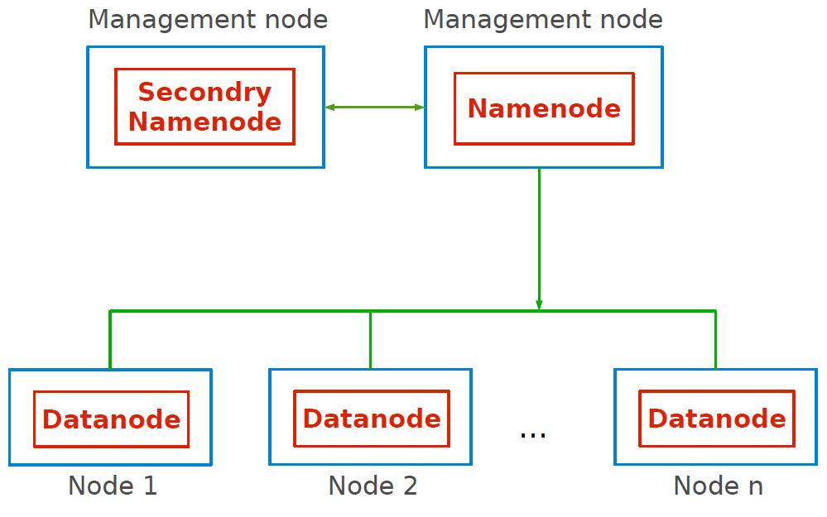
HDFS Daemons (2/2)
Engin Arslan
Distributed Filesystems
Jan 30, 2018
9 / 32

Slide 13

Files and Blocks (1/3)
◮ Files are split into blocks.
◮ Blocks
Single unit of storage: a contiguous piece of information on a disk.
Transparent to user.
Managed by Namenode, stored by Datanode.
Blocks are traditionally either 64MB or 128MB: default is 64MB.
Engin Arslan
Distributed Filesystems
Jan 30, 2018
10 / 32

Slide 14
Files and Blocks (2/3)
◮ Why is a block in HDFS so large?
Engin Arslan
Distributed Filesystems
Jan 30, 2018
11 / 32

Slide 15
Files and Blocks (2/3)
◮ Why is a block in HDFS so large?
To minimize the cost of seeks.
◮ Time to read a block = seek time + transfer time
◮ Keeping the
seektime transfertime
ratio small: we are reading data from
the disk almost as fast as the physical limit imposed by the disk.
◮ Example: if seek time is 10ms and the transfer rate is 100MB/s, to make the seek time 1% of the transfer time, we need to make the block size around 100MB.
Engin Arslan
Distributed Filesystems
Jan 30, 2018
11 / 32

Slide 16
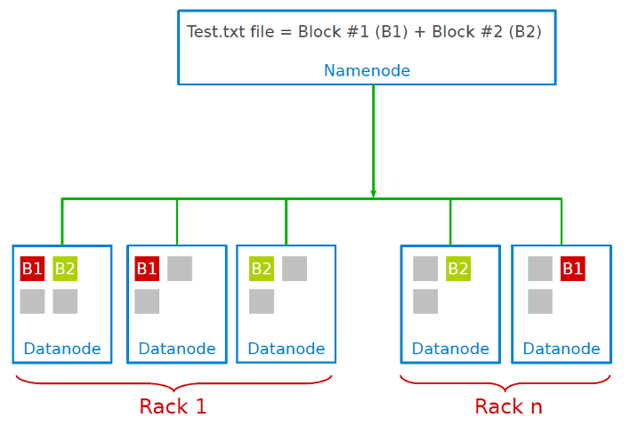
Files and Blocks (3/3)
◮ Same block is replicated on multiple machines: default is 3
Replica placements are rack aware.
1st replica on the local rack.
2nd replica on the local rack but different machine.
3rd replica on the different rack.
◮ Namenode determines replica placement.
Engin Arslan
Distributed Filesystems
Jan 30, 2018
12 / 32
Notes:
http://134.197.41.178:9870/dfshealth.html#tab-overview

Slide 17
HDFS Client
◮ Client interacts with Namenode
To update the Namenode namespace.
To retrieve block locations for writing and reading.
◮ Client interacts directly with Datanode
To read and write data.
◮ Namenode does not directly write or read data.
Engin Arslan
Distributed Filesystems
Jan 30, 2018
13 / 32

Slide 18
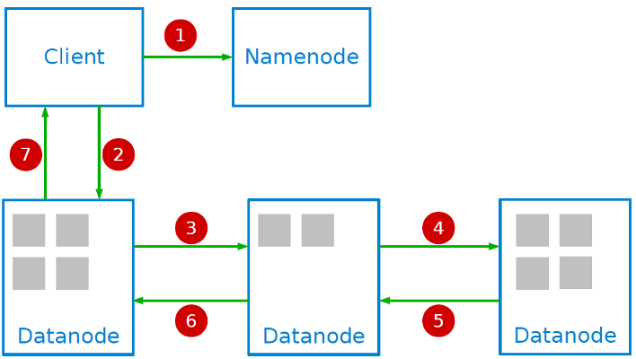
HDFS Write
◮ 1. Create a new file in the Namenode’s Namespace; calculate block topology.
◮ 2, 3, 4. Stream data to the first, second and third node.
◮ 5, 6, 7. Success/failure acknowledgment.
Engin Arslan
Distributed Filesystems
Jan 30, 2018
14 / 32

Slide 19
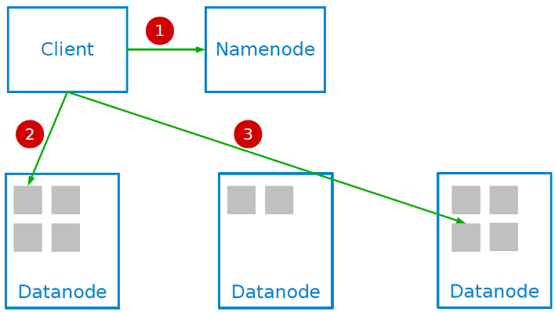
HDFS Read
◮ 1. Retrieve block locations.
◮ 2, 3. Read blocks to re-assemble the file.
Engin Arslan
Distributed Filesystems
Jan 30, 2018
15 / 32

Slide 20
Namenode Memory Concerns
◮ For fast access Namenode keeps all block metadata in-memory.
Will work well for clusters of 100 machines.
◮ Changing block size will affect how much space a cluster can host.
64MB to 128MB will reduce the number of blocks and increase the space that Namenode can support.
Engin Arslan
Distributed Filesystems
Jan 30, 2018
16 / 32

Slide 21
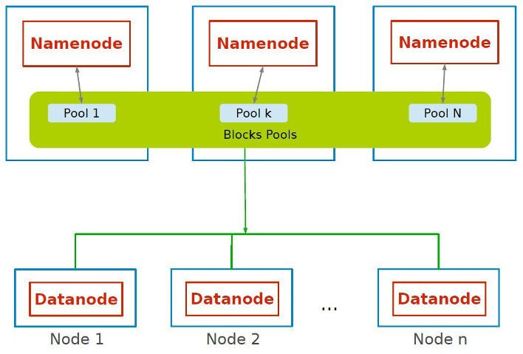
HDFS Federation
◮ Hadoop 2+
◮ Each Namenode will host part of the blocks.
◮ A Block Pool is a set of blocks that belong to a single namespace.
◮ Support for 1000+ machine clusters.
Engin Arslan
Distributed Filesystems
Jan 30, 2018
17 / 32

Slide 22
Namenode Fault-Tolerance (1/2)
◮ Namenode is a single point of failure.
◮ If Namenode crashes then cluster is down.
Engin Arslan
Distributed Filesystems
Jan 30, 2018
18 / 32

Slide 23
Namenode Fault-Tolerance (1/2)
◮ Namenode is a single point of failure.
◮ If Namenode crashes then cluster is down.
◮ Secondary Namenode periodically merges the namespace image and log and a persistent record of it written to disk (checkpointing).
◮ But, the state of the secondary Namenode lags that of the primary: does not provide high-availability of the filesystem
Engin Arslan
Distributed Filesystems
Jan 30, 2018
18 / 32

Slide 24
Namenode Fault-Tolerance (2/2)
◮ High availability Namenode.
Hadoop 2+
Active standby is always running and takes over in case main Namen- ode fails.
Engin Arslan
Distributed Filesystems
Jan 30, 2018
19 / 32

Slide 25
Summary
◮ Good for large files.
◮ Streaming access rather than random access.
◮ Daemons: Namenode, Secondary Namenode, and Datanode
Engin Arslan
Distributed Filesystems
Jan 30, 2018
20 / 32

Slide 26
HDFS Installation and Shell
Engin Arslan
Distributed Filesystems
Jan 30, 2018
21/ 32

Slide 27
HDFS Installation
◮ Three options
Local (Standalone) Mode
Pseudo-Distributed Mode
Fully-Distributed Mode
Engin Arslan
Distributed Filesystems
Jan 30, 2018
22/ 32

Slide 28
Installation - Local
◮ Default configuration after the download.
◮ Executes as a single Java process.
◮ Works directly with local filesystem.
◮ Useful for debugging.
Engin Arslan
Distributed Filesystems
Jan 30, 2018
23/ 32

Slide 29
Installation - Pseudo-Distributed (1/6)
◮ Still runs on a single node.
◮ Each daemon runs in its own Java process.
Namenode
Secondary Namenode
Datanode
◮ Configuration files:
hadoop-env.sh
core-site.xml
hdfs-site.xml
Engin Arslan
Distributed Filesystems
Jan 30, 2018
24/ 32

Slide 30
Installation - Pseudo-Distributed (2/6)
◮ Specify environment variables in hadoop-env.sh
export JAVA_HOME=/usr/lib/jvm/java-1.8.0-openjdk-amd64/
Engin Arslan
Distributed Filesystems
Jan 30, 2018
25/ 32

Slide 31
Installation - Pseudo-Distributed (3/6)
◮ Specify location of Namenode in core-site.sh
<property>
<name>fs.defaultFS</name>
<value>hdfs://localhost:8020</value>
<description>NameNode URI</description>
</property>
Engin Arslan
Distributed Filesystems
Jan 30, 2018
26/ 32

Slide 32
Installation - Pseudo-Distributed (4/6)
◮ Configurations of Namenode in hdfs-site.sh
◮ Path on the local filesystem where the Namenode stores the namespace and transaction logs persistently.
<property>
<name>dfs.namenode.name.dir</name>
<value>/opt/hadoop-2.2.0/hdfs/namenode</value>
<description>description...</description>
</property>
Engin Arslan
Distributed Filesystems
Jan 30, 2018
27/ 32

Slide 33
Installation - Pseudo-Distributed (5/6)
◮ Configurations of Secondary Namenode in hdfs-site.sh
◮ Path on the local filesystem where the Secondary Namenode stores the temporary images to merge.
<property>
<name>dfs.namenode.checkpoint.dir</name>
<value>/opt/hadoop-2.2.0/hdfs/secondary</value>
<description>description...</description>
</property>
Engin Arslan
Distributed Filesystems
Jan 30, 2018
28/ 32

Slide 34
Installation - Pseudo-Distributed (6/6)
◮ Configurations of Datanode in hdfs-site.sh
◮ Comma separated list of paths on the local filesystem of a Datanode where it should store its blocks.
<property>
<name>dfs.datanode.data.dir</name>
<value>/opt/hadoop-2.2.0/hdfs/datanode</value>
<description>description...</description>
</property>
Engin Arslan
Distributed Filesystems
Jan 30, 2018
29/ 32

Slide 35
Start HDFS and Test
◮ Format the Namenode directory (do this only once, the first time).
hdfs namenode -format
Engin Arslan
Distributed Filesystems
Jan 30, 2018
30 / 32

Slide 36
Start HDFS and Test
◮ Format the Namenode directory (do this only once, the first time).
hdfs namenode -format
◮ Start the Namenode, Secondary namenode and Datanode daemons.
hadoop-daemon.sh start namenode
hadoop-daemon.sh start secondarynamenode
hadoop-daemon.sh start datanode
jps
Engin Arslan
Distributed Filesystems
Jan 30, 2018
30 / 32

Slide 37
Start HDFS and Test
◮ Format the Namenode directory (do this only once, the first time).
hdfs namenode -format
◮ Start the Namenode, Secondary namenode and Datanode daemons.
hadoop-daemon.sh start namenode
hadoop-daemon.sh start secondarynamenode
hadoop-daemon.sh start datanode
jps
◮ Verify the deamons are running:
Namenode: http://localhost:50070
Secondary Namenode: http://localhost:50090
Datanode: http://localhost:50075
Engin Arslan
Distributed Filesystems
Jan 30, 2018
30 / 32

Slide 38
HDFS Shell
hdfs dfs -<command> -<option> <path>
Engin Arslan
Distributed Filesystems
Jan 30, 2018
31 / 32

Slide 39
HDFS Shell
hdfs dfs -<command> -<option> <path>
hdfs dfs -ls /
hdfs dfs -ls file:///home/big
hdfs dfs -ls hdfs://localhost/
hdfs dfs -cat /dir/file.txt
hdfs dfs -cp /dir/file1 /otherDir/file2
hdfs dfs -mv /dir/file1 /dir2/file2 hdfs dfs -mkdir /newDir
hdfs dfs -put file.txt /dir/file.txt # can also use copyFromLocal
hdfs dfs -get /dir/file.txt file.txt # can also use copyToLocal
hdfs dfs - rm /dir/fileToDelete
hdfs dfs -help
Engin Arslan
Distributed Filesystems
Jan 30, 2018
31 / 32

Slide 40
Questions?
Engin Arslan
Distributed Filesystems
Jan 30, 2018
32 / 32

